Slide 1
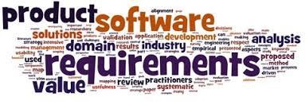
Software Requirement Engineering
Establishing the business requirements
Week # 6

Slide 2
Content
• Establishing the business requirements
• Defining business requirements
• Vision and scope document
• Scope representation techniques

Slide 4
Defining Business Requirements
• “Business requirements” refers to a set of information that, in the aggregate, describes a need that leads to one or more projects to deliver a solution and the desired ultimate business outcomes.
• Business opportunities, business objectives, success metrics, and a vision statement make up the business requirements.
• The business requirements provide a reference for making decisions about proposed requirement changes and enhancements.

Slide 5
Identifying desired business benefits
• The business requirements set the context for, and enable the measurement of, the benefits the business hopes to achieve from undertaking a project.
• Organizations should not initiate any project without a clear understanding of the value it will add to the business.
• Set measurable targets with business objectives, and then define success metrics that allow you to measure whether you are on track to meet those objectives.

Slide 7
Product vision and project scope
• Two core elements of the business requirements are the vision and the scope.
• The product vision describes the ultimate product that will achieve the business objectives.
• This product could serve as the complete solution for the business requirements or as just a portion of the solution.

Slide 8
Product vision and project scope
• Two core elements of the business requirements are the vision and the scope.
• The product vision describes the ultimate product that will achieve the business objectives.
• This product could serve as the complete solution for the business requirements or as just a portion of the solution.
• The vision describes what the product is about and what it ultimately could become.

Slide 9
Product vision and project scope
• It provides the context for making decisions throughout the product’s life, and it aligns all stakeholders in a common direction.
• The project scope identifies what portion of the ultimate product vision the current project or development iteration will address.
• The statement of scope draws the boundary between what’s in and what’s out for this project.

Slide 11
Vision and scope document
• The vision and scope document collects the business requirements into a single deliverable that sets the stage for the subsequent development work.
• Organizations that build commercial software often create a market (or marketing) requirements document (MRD).
• An MRD might go into more detail about the target market segments and the issues that pertain to commercial success.

Slide 12
Vision and scope document
• Figure 2-2 suggests a template for a vision and scope document;
• Some elements of the vision and scope document might be reusable from project to project, such as business objectives, business risks, and stakeholder profiles.
Figure 2-2 Template for a vision and scope document.

Slide 13
Project charter
Other teams might store that information in
a project charter, using a template like the one in Figure 2.3 (Wiegers
2007). Both templates, with embedded guidance text, are available for
downloading from the website that accompanies this book.
Figure 2.3 Suggested template for a project charter (from Practical
Project Initiation by Karl E. Wiegers).

Slide 14
Vision and scope document
1.1 Background
Identifying business problems
A business problem is any issue that prevents the business from achieving its goals or exploiting an opportunity (Beatty and Chen 2012).
A business problem can be small, such as a user complaint that some task takes too long, which can perhaps be solved by streamlining some functionality. Or it can be as large as organization-level business challenges—spending too much money, not making enough money,

Slide 15
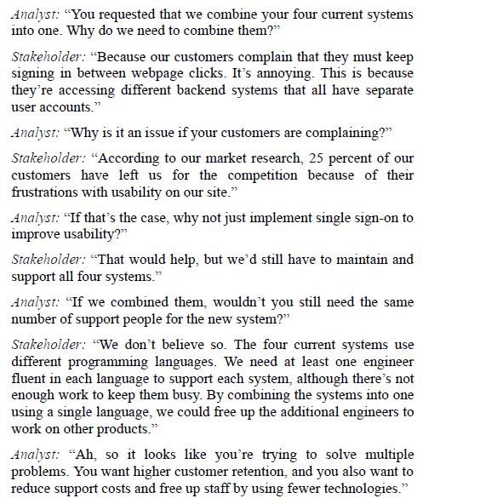

Slide 16
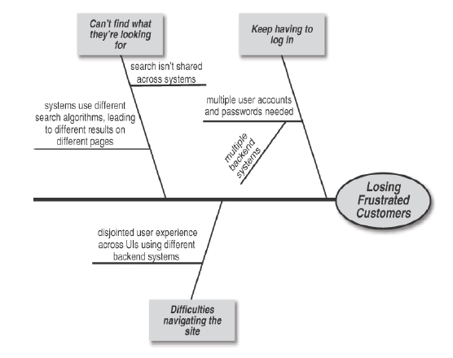
Figure 2.1 A root cause analysis (fishbone or Ishikawa) diagram
example shows the factors that contribute to the stated problem.

Slide 17
Keeping the Business Problem in Focus
When the key stakeholders have agreed upon a clear understanding of the
core business concerns, consider writing a problem statement (Kyne 2022).
A template like this can be helpful (Compton 2022):
Situation Describe the background, context, and environment.
Problem Describe the business problems or opportunities as you
now understand them.
Implication Describe the likely results if the problem isn’t solved.
Benefit State the business value of solving the problem.
Vision Describe what the desired future state would look like

Slide 18
Scope & Vision
Business Requirements
Some people use the term business requirement to refer to any
requirement, including bits of requested functionality, that comes from the business, but that’s not how we use the term. We’re referring to information that explains why the organization has decided to undertake the project and what value they expect it to deliver (Wiegers and Beatty 2013).

Slide 19
Questions to ask
What business problem are you trying to solve or what business opportunity do you perceive?
What’s the motivation for solving this problem or pursuing this opportunity, or what points of pain do you hope to relieve?
What are your business objectives? Why aren’t you already achieving those desired outcomes?
How would the proposed product provide value to the organization, the company, your customers, or humanity as a whole?
What would a highly successful solution do for you? Can you quantify its potential payoff?
How could you judge the solution’s success?

Slide 20
Questions to ask cont…
What could the business impact be if you don’t pursue this solution?
Which individuals, groups, products, systems, or projects could influence or be affected by this project?
What are the timing goals or constraints for delivering a partial solution? A complete solution?
If the organization unsuccessfully tried to solve this problem previously, why did the attempt fail and what should the team do differently this time?
What assumptions are you making regarding the proposed initiative? What risks do you see associated with it?

Slide 21
Business objectives
Business objectives let you determine when a business problem is solved, a need is fulfilled, or an opportunity is exploited. Business objectives can be financial or nonfinancial, internal (operations) or outward facing (products), strategic or tactical.
Setting targets in the form of business objectives lets the decision makers define the scope of work needed to achieve them. The objectives help ensure that the solution includes all the necessary functionality while avoiding extraneous features that don’t contribute to the desired business outcomes.
Defining the business objectives up front drives the creation of the solution concept. That concept then leads to activities to define the solution’s specific features and attributes, a process called requirements elicitation.

Slide 22
Figure 2.4 A business objectives model links business problems,
business objectives, success metrics, and solution concepts.

Slide 23
Success Metrics
Success metrics let you judge progress and your solution’s contributions toward your objectives. In some cases, the objective lends itself to direct measurement.
The business objective stated earlier—“Achieve a market share of at least 45 percent in the region by October 1, 2024”—is one of those, assuming you can track your market share as a function of time.
However, many business objectives are both lagging indicators (you can’t be sure until the end) and potentially influenced by factors beyond your solution. In these situations, you must use metrics that are proxies or surrogates that indicate whether your solution is on track toward achieving the overall business objectives.

Slide 24
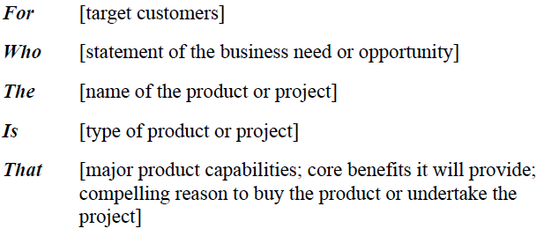
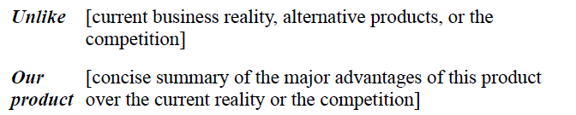
1.5 Vision statement

Slide 25
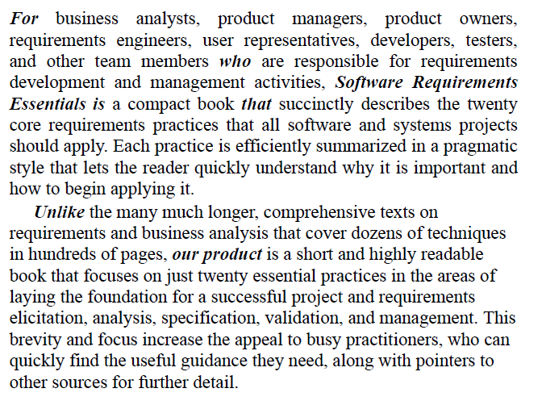
1.5 Vision statement

Slide 26
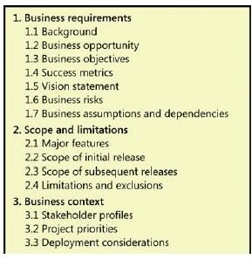
Vision and scope document
• Figure 2-2 suggests a template for a vision and scope document;

Slide 27
Project Charter
Figure 2-3 suggests a template for a Project Charter document;
Figure 2.3 Suggested template for a project charter (from Practical
Project Initiation by Karl E. Wiegers).

Slide 28
Define the solution’s boundaries.
When you start a new initiative, you have funding to solve one or more business problems and a high-level concept of a possible solution.
However, you might not know exactly where to draw the line between what the solution should and should not include
Questions like these can help you figure all that out.
Which business processes, functions, and events will be part of the solution? Which ones will remain outside it?
Who will use or derive benefits from the solution? Who is excluded?
Which software systems will be part of the solution? What will the interfaces between them look like?
Where do each system’s responsibilities begin and end?
What data sets, sources, and operations will be incorporated into the solution?
How do we fit our solution into the rest of our universe?
How do we know where to stop?

Slide 30
Scope representation techniques
• Context diagrams, ecosystem maps, feature trees, and event lists are the most common ways to represent scope visually.
• Identifying affected business processes also can help define the scope boundary.
• Use case diagrams can depict the scope boundary between use cases and actors.

Slide 31
Context diagrams
• The scope description establishes the boundary and connections between the system you’re developing.
• The context diagram visually illustrates this boundary.
• It identifies external entities (also called terminators) outside the system that interface to it in some way, as well as data, control, and material flows between the terminators and the system.

Slide 32
Figure 2.5 A context diagram shows the immediate environment of the
restaurant’s new online ordering site.

Slide 33
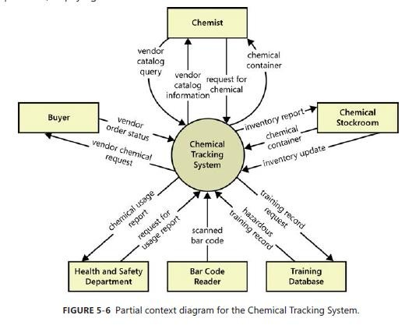

Slide 34
Ecosystem map
• An ecosystem map shows all of the systems related to the system of interest that interact with one another and the nature of those interactions.
• An ecosystem map represents scope by showing all the systems that interconnect and that therefore might need to be modified to accommodate your new system.
• Ecosystem maps differ from context diagrams in that they show other systems that have a relationship with the system you’re working on, including those without direct interfaces.

Slide 35
Figure 2.6 An ecosystem map shows how the restaurant’s current and
future systems are interconnected.

Slide 36
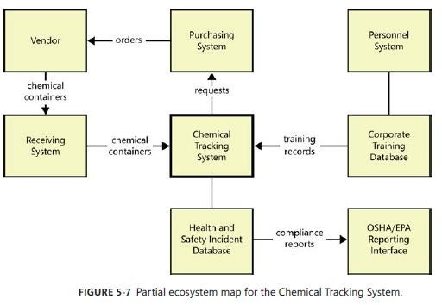

Slide 37
Feature tree
• A feature tree is a visual depiction of the product’s features organized in logical groups, hierarchically subdividing each feature into further levels of detail.
• The feature tree provides a concise view of all of the features planned for a project, making it an ideal model to show to executives who want a quick glance at the project scope.
• A feature tree can show up to three levels of features, commonly called level 1 (L1), level 2 (L2), and level 3 (L3).
• L2 features are sub-features of L1 features, and L3 features are sub- features of L2 features.

Slide 38
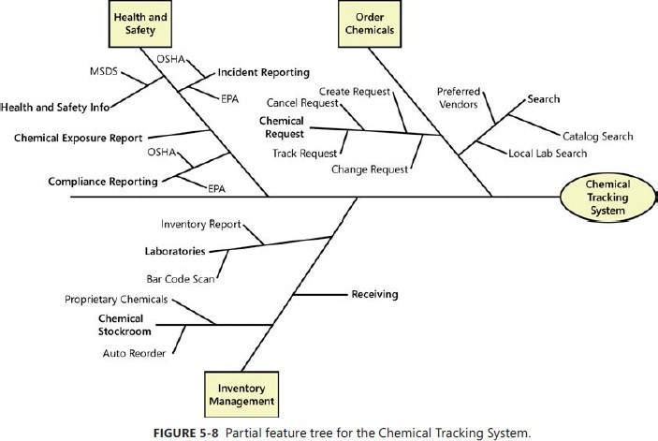

Slide 39
Event list
• An event list identifies external events that could trigger behavior in the system.
• The event list depicts the scope boundary for the system by naming possible business events triggered by users, time-triggered (temporal) events, or signal events received from external components, such as hardware devices.
• The event list only names the events; the functional requirements that describe how the system responds to the events would be detailed in the SRS by using event-response tables.

Slide 40
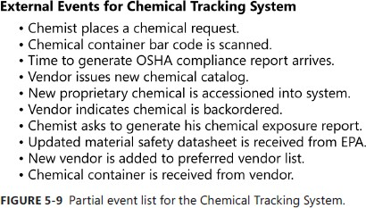

Slide 41
3. Business context
3.1 Stakeholder profiles
Each stakeholder profile should include the following information:
■ The major value or benefit that the stakeholder will receive from the product. Stakeholder value could be defined in terms of:
• Improved productivity.
• Reduced rework and waste.
• Cost savings.
• Streamlined business processes.
• Automation of previously manual tasks.
• Ability to perform entirely new tasks.
• Compliance with pertinent standards or regulations.
• Improved usability compared to current products.
■ Their likely attitudes toward the product.
■ Major features and characteristics of interest.
■ Any known constraints that must be accommodated.

Slide 42
Project priorities
The project manager’s challenge is to adjust the degrees of freedom to achieve the project’s success drivers within the limits imposed by the constraints. Suppose marketing suddenly demands that you release the product one month earlier than scheduled. How do you respond? Do you:
■ Defer certain requirements to a later release?
■ Shorten the planned system test cycle?
■ Demand overtime from your staff or hire contractors to accelerate development?
■ Shift resources from other projects to help out?

Slide 43
Summary
• Establishing the business requirements
• Defining business requirements
• Vision and scope document
• Scope representation techniques

